Slide 1
VE281 Midterm Distribution

Slide 2
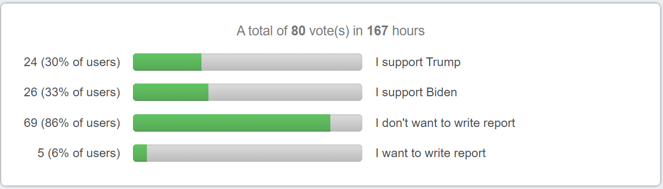
Biden Won Afterall
How Similar to our Piazza Poll!
Trump was ahead but Biden had a cameback
Don’t give up too early!

Slide 3
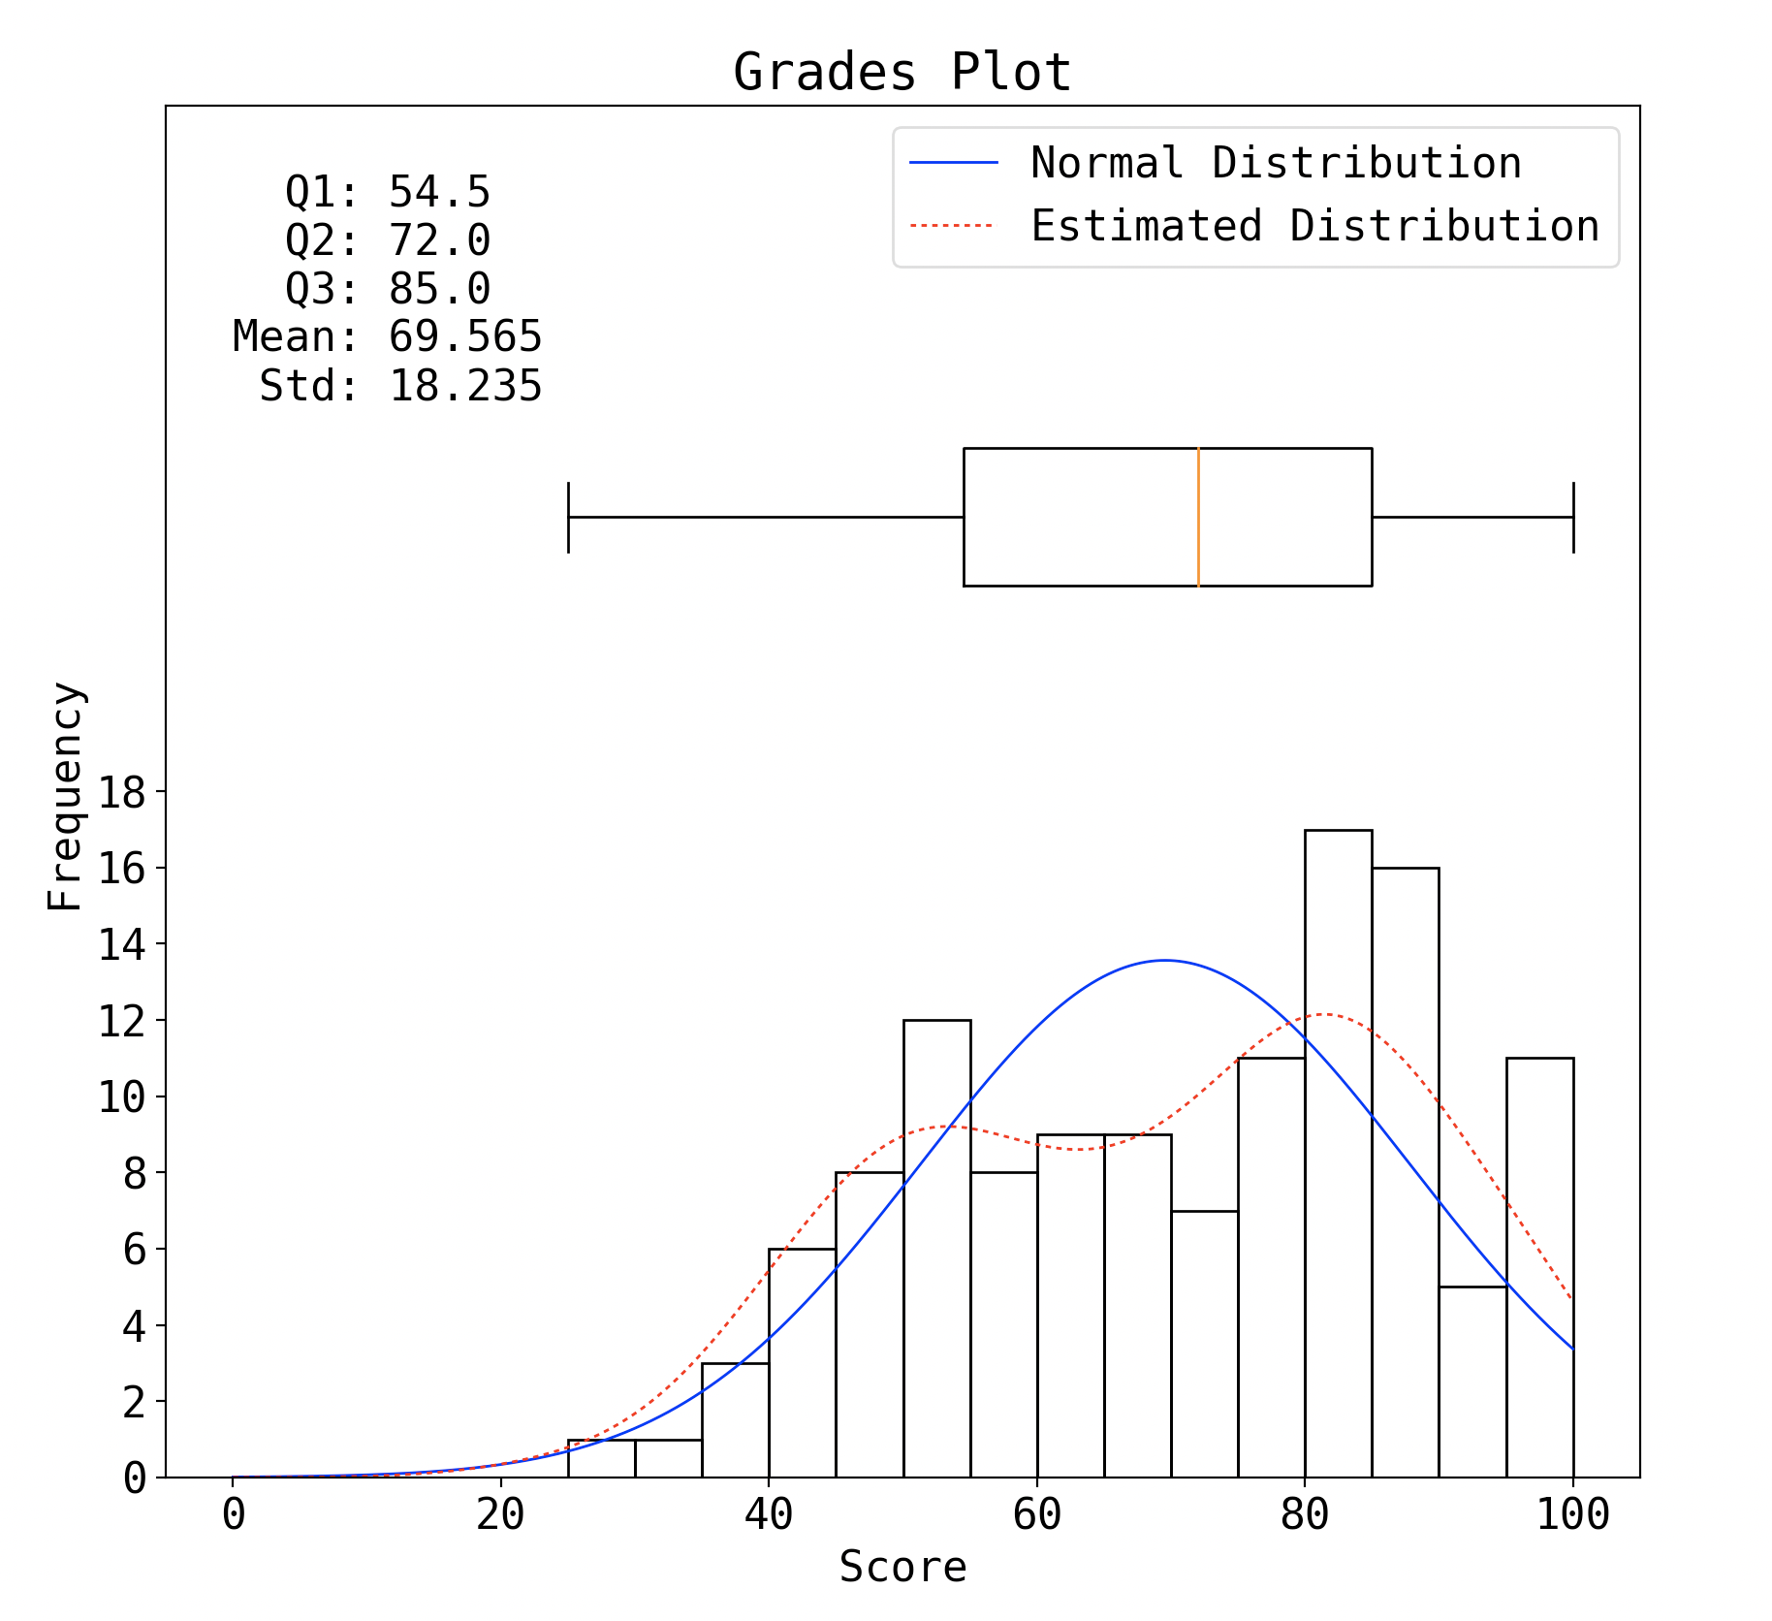
Overall Distribution

Slide 4
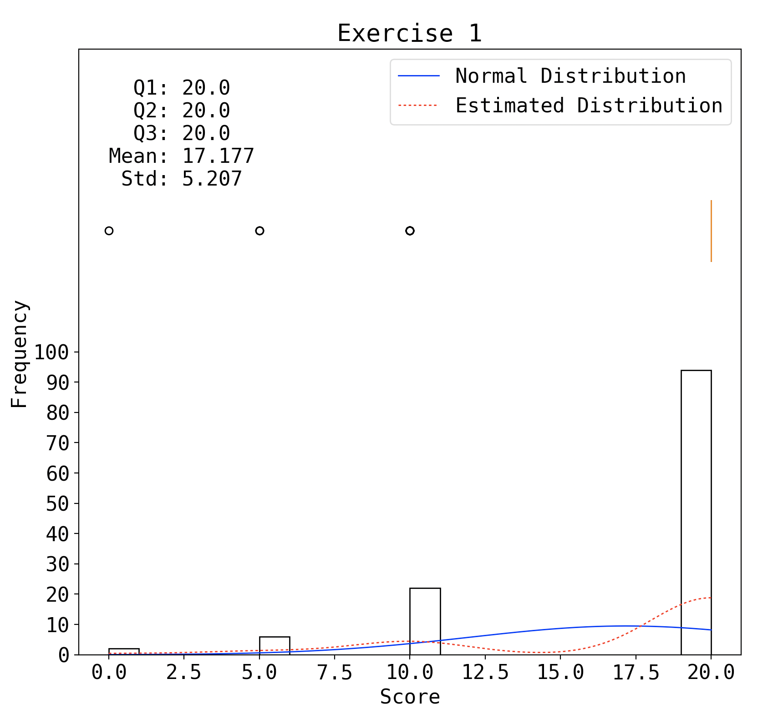
P1

Slide 5
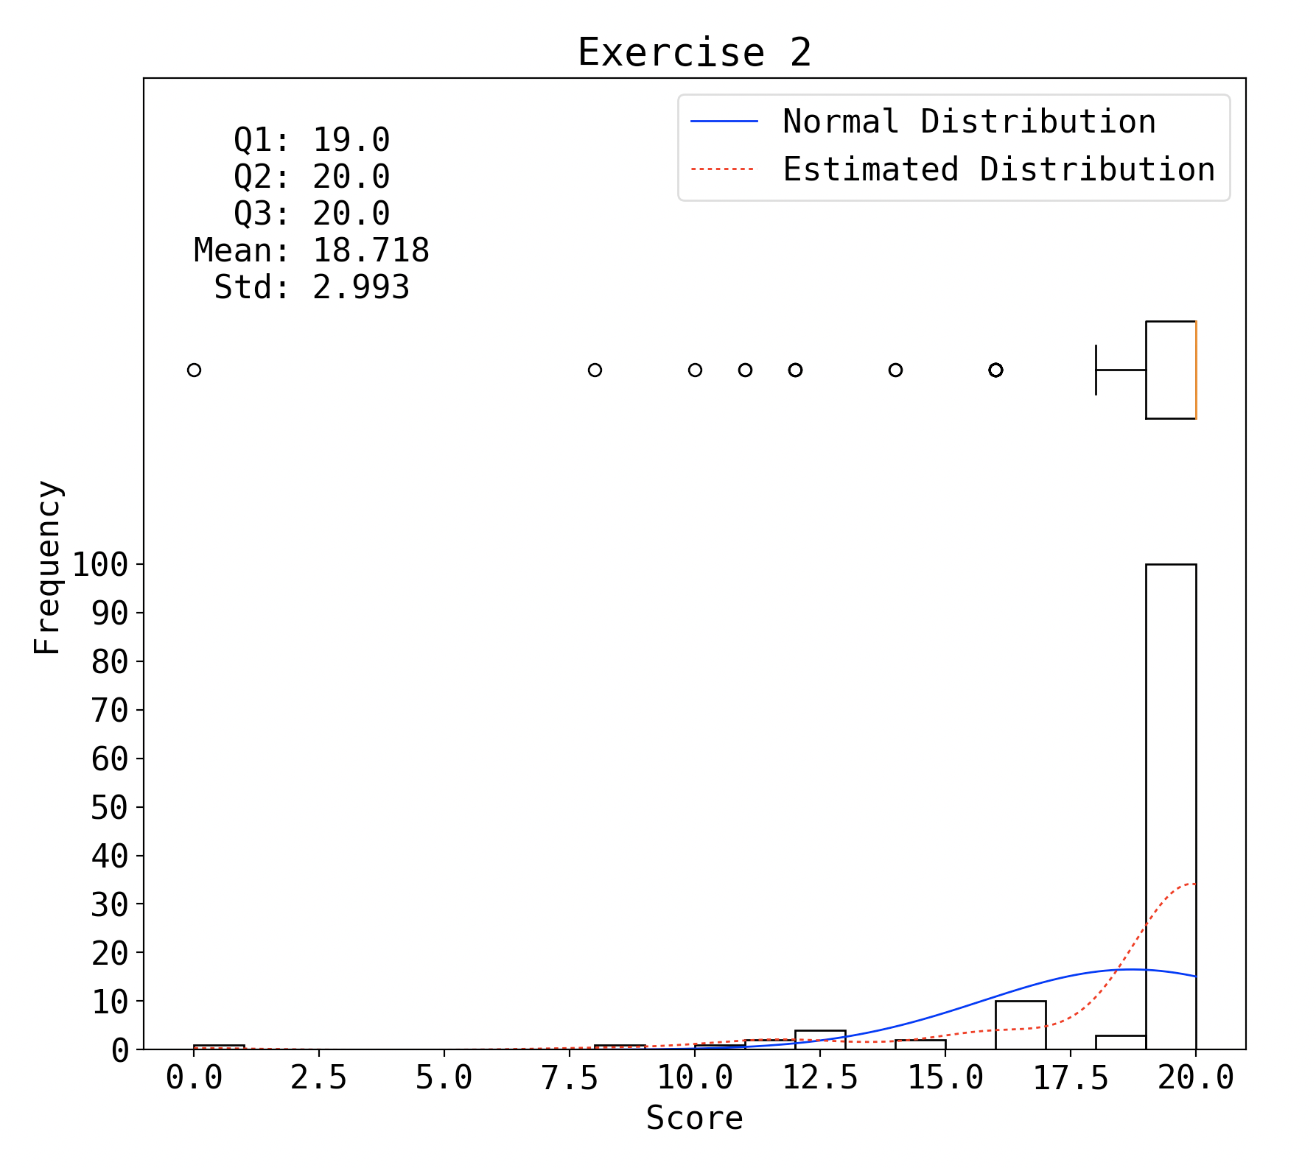
P2

Slide 6
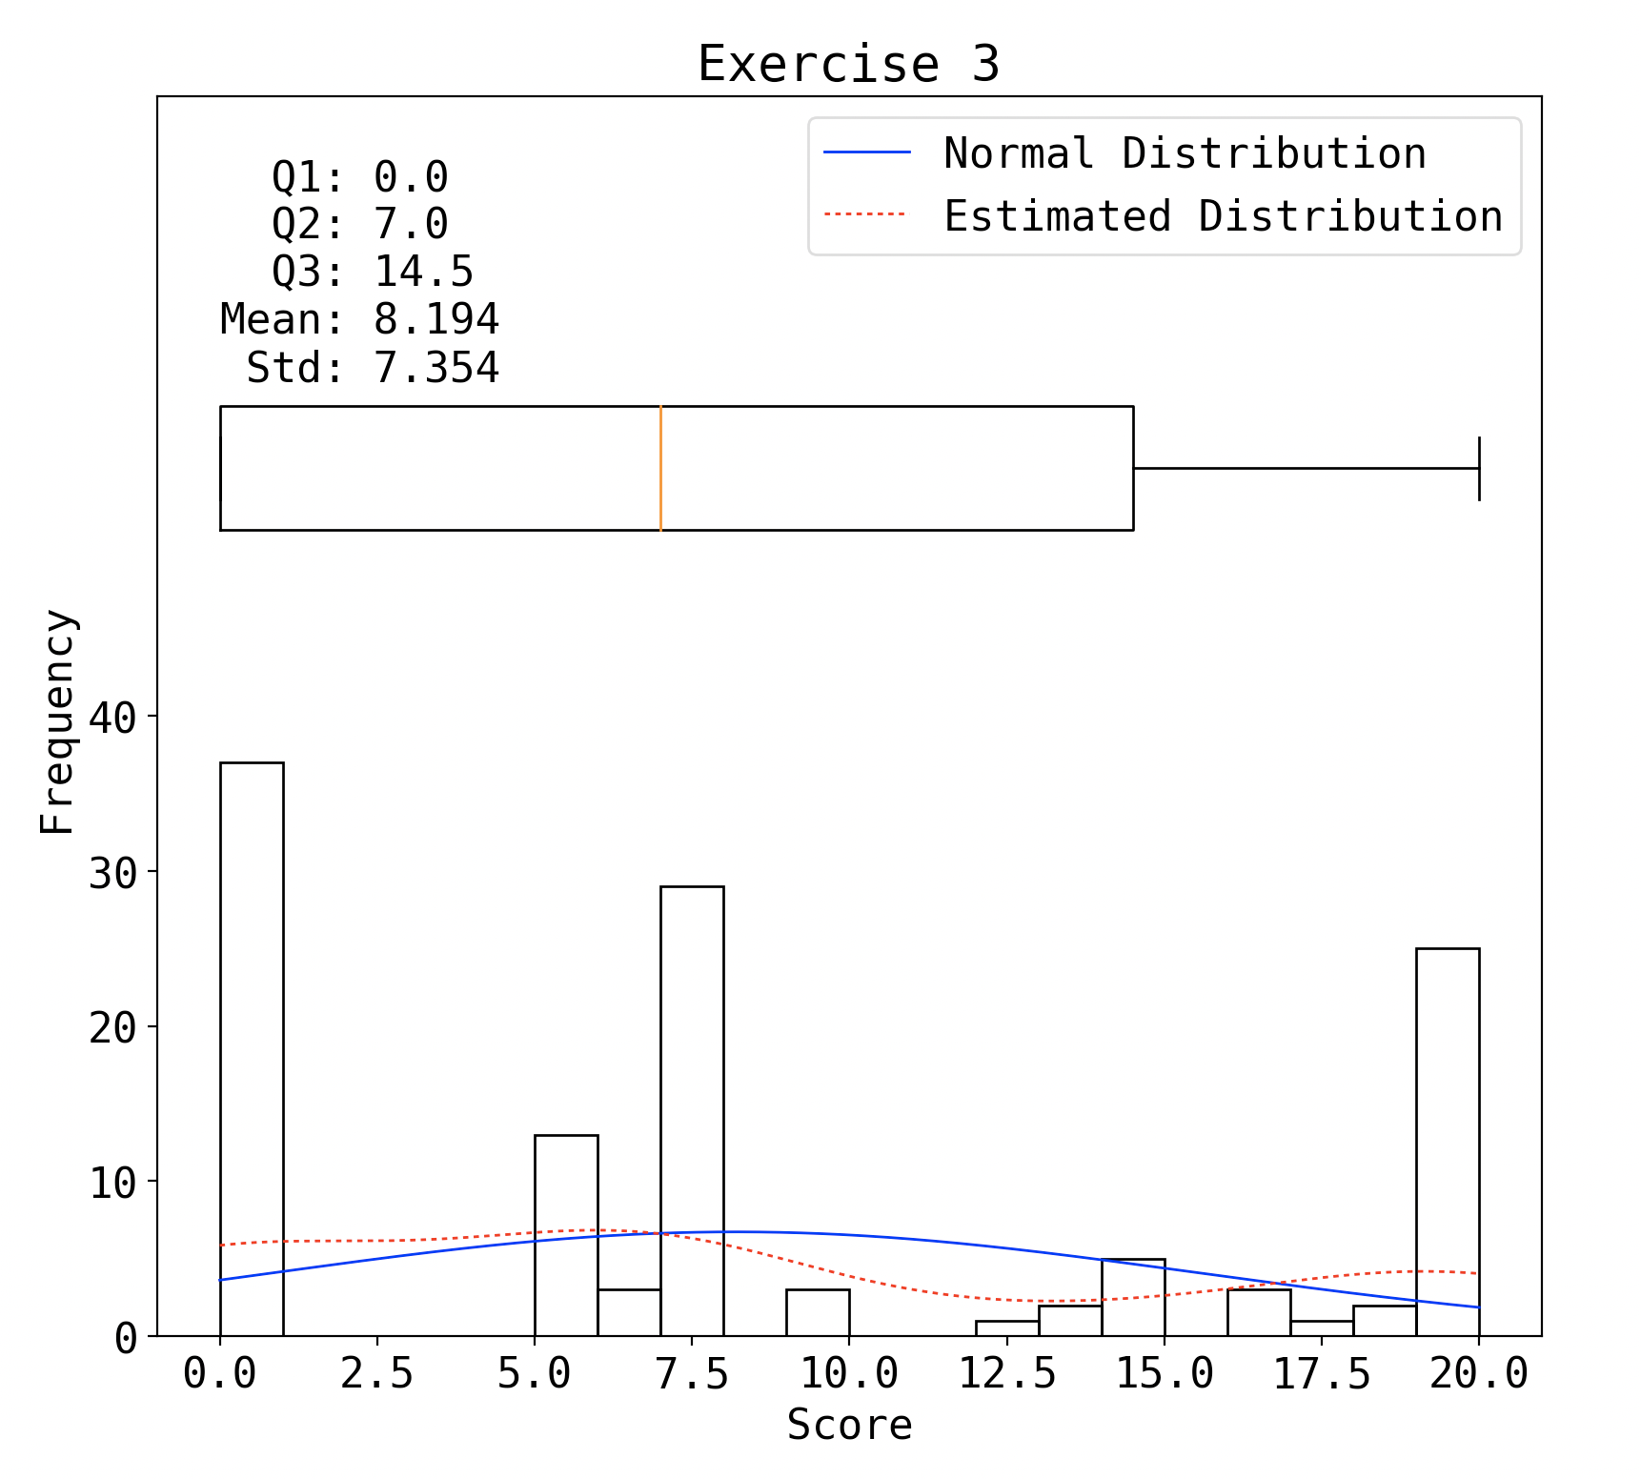
P3

Slide 7
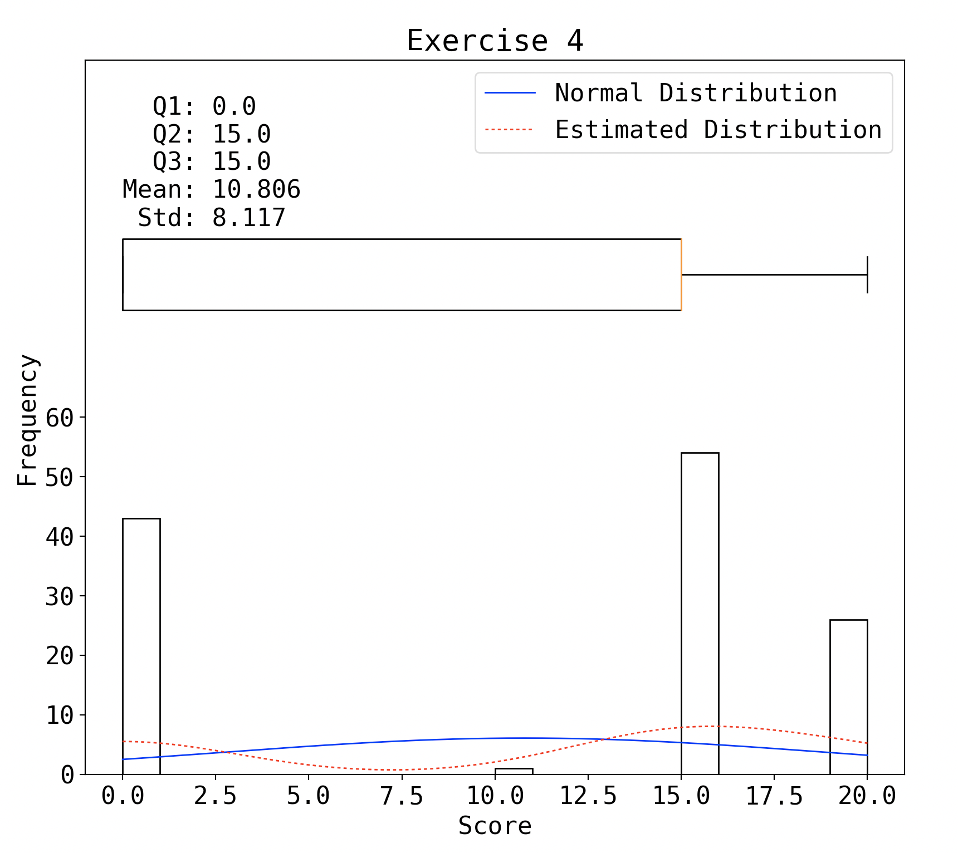
P4

Slide 8
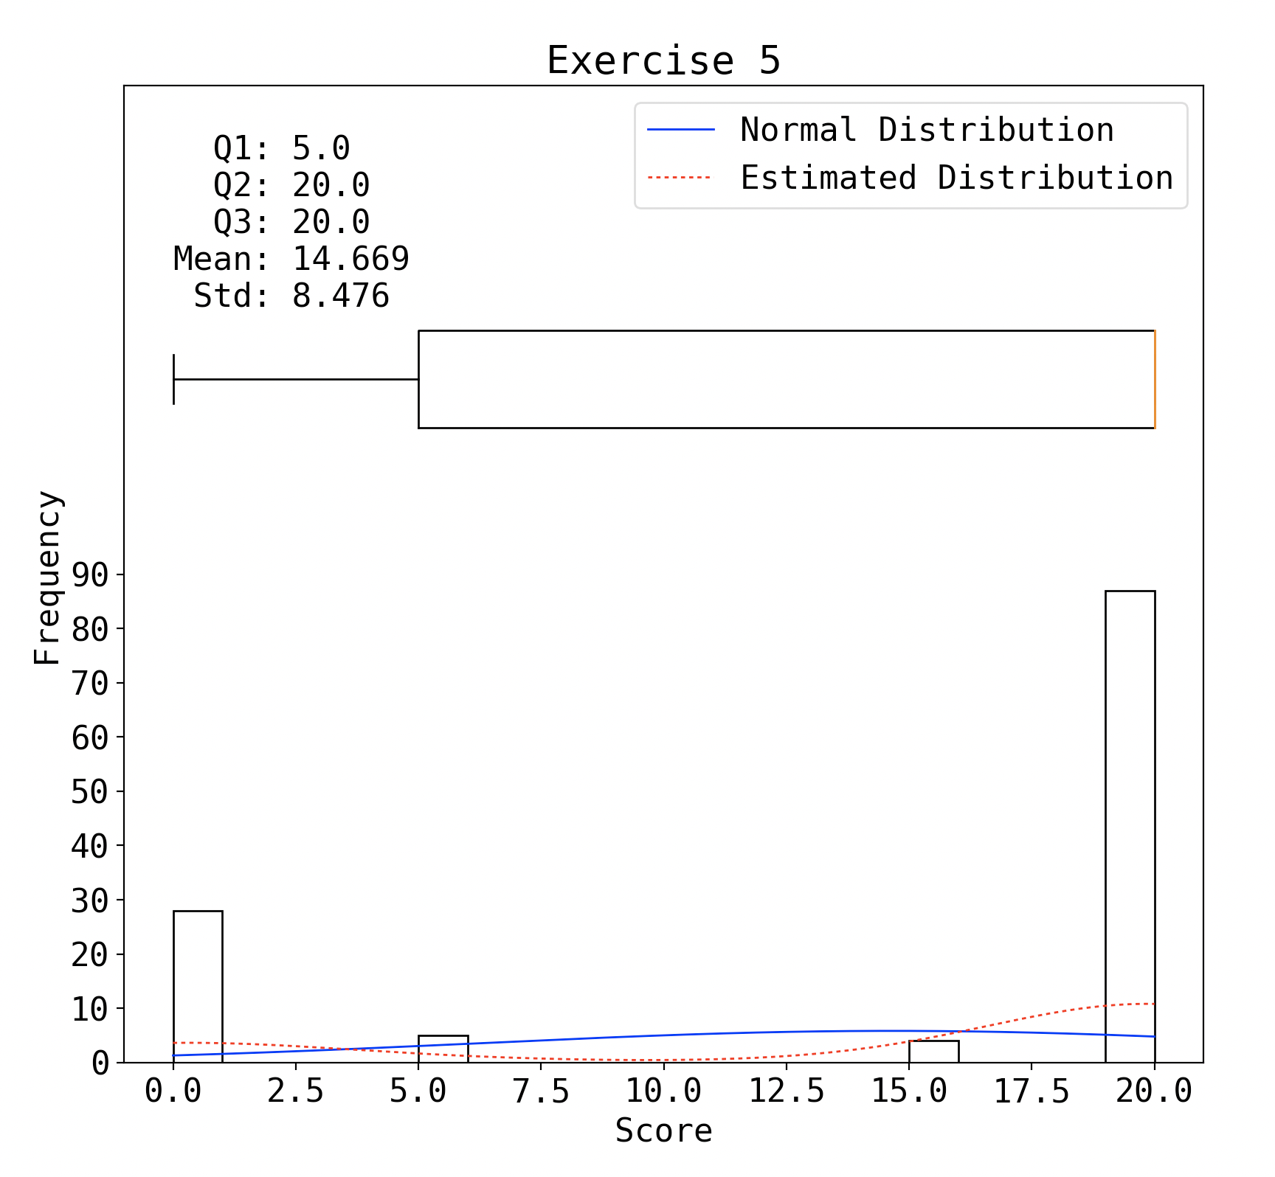
P5

Slide 9
Regrading
This Friday RC time
8-10 PM
Location: JI Building, Room 326H

Slide 10
Ranged Search in K-d Tree

Slide 11
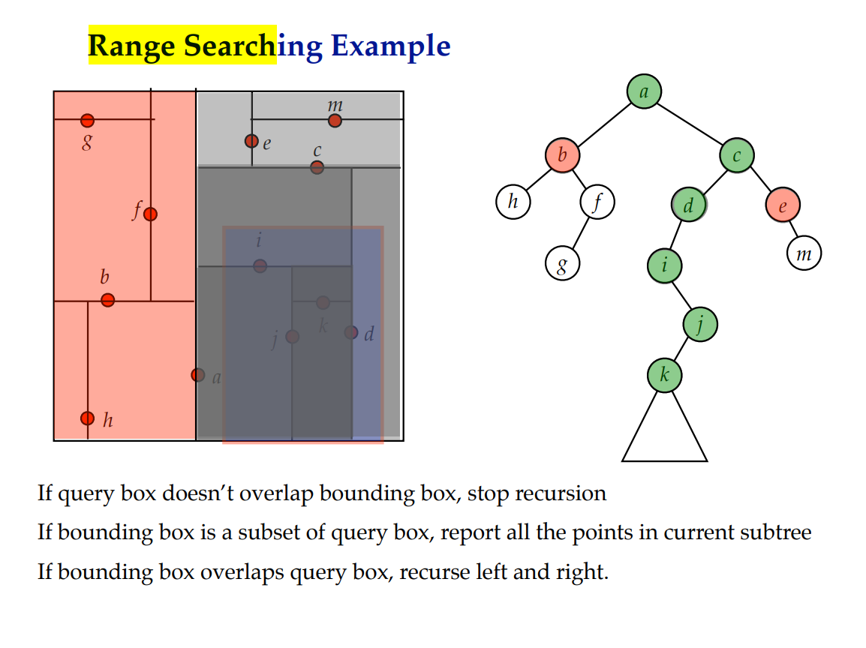

Slide 12
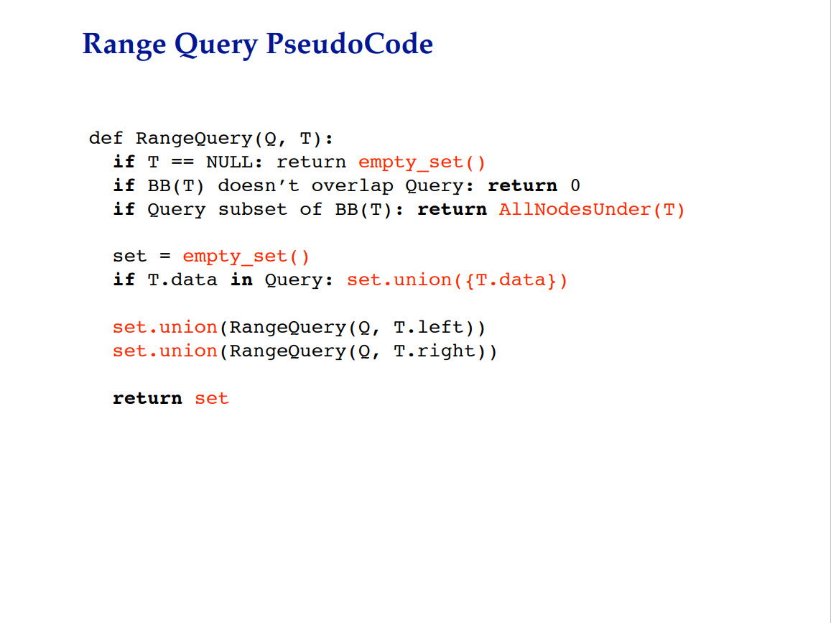

Slide 13
VE281 Data Structures and Algorithms
Tries
Learning Objectives:
Know what a trie is and understand its difference between binary search trees
Know how to implement search, insertion, and removal for a trie

Slide 14
Trie
The word “trie” comes from retrieval.
To distinguish with “tree”, it is pronounced as “try”.
A trie is a tree that uses parts of the key, as opposed to the whole key, to perform search.
Data records are only stored in leaf nodes. Internal nodes do not store records; they are “branch” points to direct the search process.
c
d
o
o
u
a
cat
cow
dog
duck

Slide 15
Trie
Trie usually is used to store a set of strings from an alphabet.
The alphabet is in the general sense, not necessarily the English alphabet.
For example, {0, 1} is an alphabet for binary codes {0010, 0111, 101}. We can store these three codes using a trie.
c
d
o
o
u
a
cat
cow
dog
duck
0
1
0
1
101
0010
0111

Slide 16
Trie
Each edge of the trie is labeled with symbols from the alphabet.
Labels of edges on the path from the root to any leaf in the trie forms a prefix of a string in that leaf.
Trie is also called prefix-tree.
c
d
o
o
u
a
cat
cow
dog
duck

Slide 17
Trie
The most significant symbol in a string determines the branch direction at the root.
Each internal node is a “branch” point.
As long as there is only one key in a branch, we do not need any further internal node below that branch; we can put the word directly as the leaf of that branch.
c
d
o
o
u
a
cat
cow
dog
duck
Notes:
In this example, we directly put duck below edge “u”.

Slide 18
Trie Implementation Issue
Sometimes, a string in the set is exactly a prefix of another string.
For example, “ant” is a prefix of “anteater”.
How can we make “ant” as a leaf in the trie?
We add a symbol to the alphabet to indicate the end of a string. For example, use “$” to indicate the end.
a
c
d
n
o
o
u
t
a
$
e
cat
cow
dog
duck
ant
anteater

Slide 19
Trie Implementation Issue
We can keep an array of pointers in a node, which corresponds to all possible symbols in the alphabet.
However, most internal nodes have branches to only a small fraction of the possible symbols in the alphabet.
An alternate implementation is to store a linked list of pointers to the child nodes.
a
b
…
z
a
i
o

Slide 20
Trie Search
Follow the search path, starting from the root.
When there is no branch, return false.
When the search leads to a leaf, further compare with the key at the leaf.
search “monkey”
c
d
search “cat”
o
o
u
a
cat
cow
dog
duck

Slide 21
Trie Insertion
Follow the search path, starting from the root.
If a new branch is needed, add it.
When the search leads to a leaf, a conflict occurs. We need to branch.
Use the next symbol in the key
The originally-unique word must be moved to lower level
c
d
d
insert “cow”
insert “cat”
cow
o
u
o
u
c
d
dog
duck
dog
duck
o
o
u
a
cat
cow
dog
duck

Slide 22
Trie Removal
The key to be removed is always at the leaf.
After deleting the key, if the parent of that key now has only one child C, remove the parent node and move key C one level up.
If key C is the only child of its new parent, repeat the above procedure again.
c
d
c
d
remove “cat”
cow
o
o
u
o
u
a
cat
cow
dog
duck
dog
duck

Slide 23
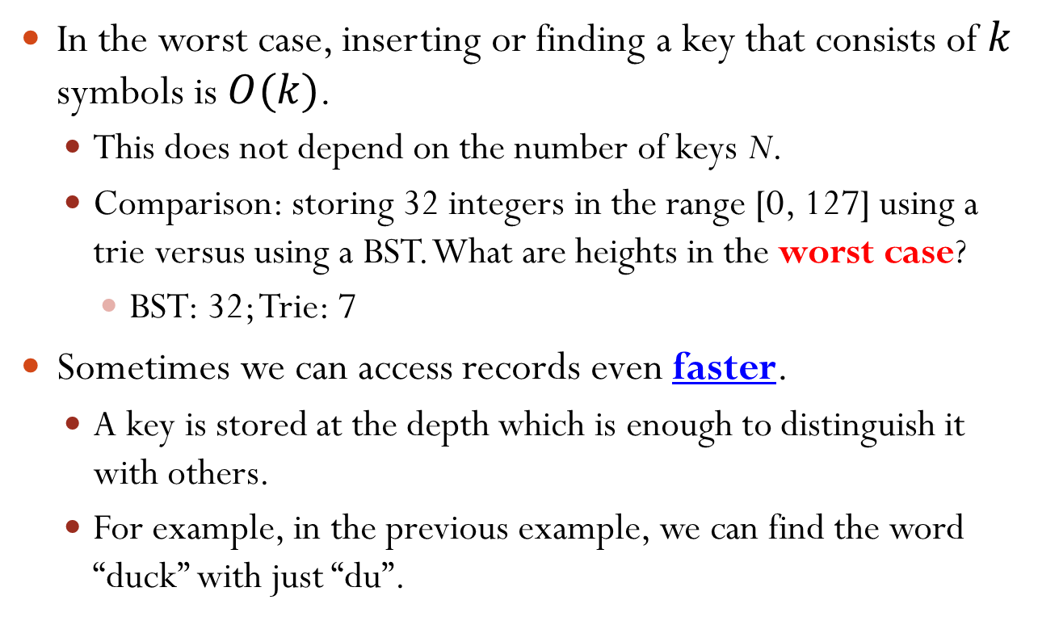
Time Complexity of Trie
In the worst case, inserting or finding a key that consists of $k$ symbols is $O(k)$.
This does not depend on the number of keys N.
Comparison: storing 32 integers in the range [0, 127] using a trie versus using a BST. What are heights in the worst case?
BST: 32; Trie: 7
Sometimes we can access records even faster.
A key is stored at the depth which is enough to distinguish it with others.
For example, in the previous example, we can find the word “duck” with just “du”.
Notes:
32 integers with BST, worst case is height 32; with trie, it is 7 (7 bits for integers in the range [0, 127]).

Slide 24
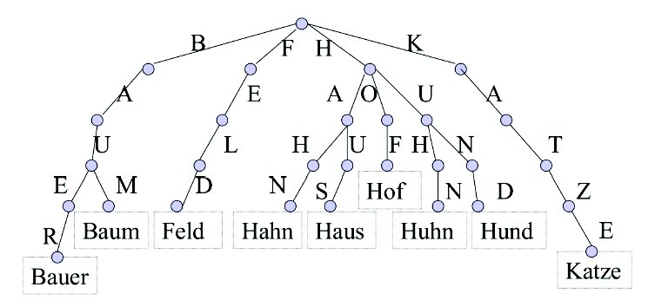
Use Case – Spell Checking

Slide 25
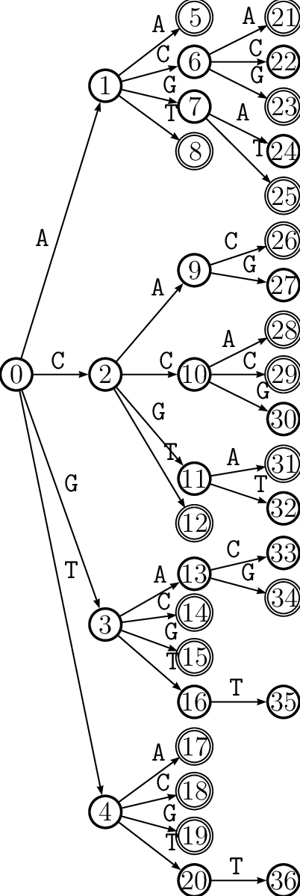
Use Case – Human Genome

Slide 26
Example: Context Aware Seeds (My Research)
Published in Algorithms in Molecular Biology 2020

Slide 27
Compute the Confidence Radii
Confident radius: min edit-distance (ED) to non-immediate neighbors
Find all neighbors
Find non-immediate neighbors
Get the minimum ED

Slide 28
Suffix Trie
Convert the reference into a suffix trie
R
R
R
Ref:
R
Ref:
Ref:
Ref:
GCCCAGATC
GCCCAGATC
GCCCAGATC
GCCCAGATC
A
A
C
C
G
G
T
A
C
G
T
A
C
G
T
T
G
G
T
T
A
A
C
C
A
A
C
C
C
G
T
A
C
A
C
C
G
T
A
C
A
C
C
C

Slide 29
Dynamic Programming
A recurrence relationship
a, b can be neighbors only if P(a), P(b) are neighbors
a
a
GCCCAGC
GCCCAGC
P(a)
GCCCAG
b
GCCCACC
c_{max} = 1
a
a
GCCCAGC
a
GCCCAGC
GCCCAGC
Neighbors
Not Neighbors
Not Neighbors
b
b’
GCCCCCC
b
GCCCACT
GCCCACC
P(a)
GCCCAG
P(a)
GCCCAG
Neighbors
Not Neighbors
P(b)
GCCCAC
P(b)
GCCCCC

Slide 30
Find Neighbors
Initialization: find all neighbors of the root node
Iterate the suffix trie: top-to-bottom
Find neighbors for children nodes
Invariant: all neighbors of current node is found

Slide 31
Initialize Root
c_{max} = 1
R
R
Ref:
GCCCAGATC
R
Children of R :
R, A, C, G, T
A
A
A
C
C
C
G
G
G
T
T
T
Neighbors of R :
R, A, C, G, T
G
G
G
T
T
T
A
A
A
C
C
C
A
A
A
C
C
C
C
C
C

Slide 32
Iterate Trie—Build Neighbor List
c_{max} = 1
R
R
Ref:
GCCCAGATC
R
Children of R :
R, A, C, G, T
A
C
G
T
A
C
G
T
A
C
G
T
Neighbors of R :
R, A, C, G, T
G
T
A
C
A
C
C
G
T
A
C
A
C
C
G
T
A
C
A
C
C
x is a neighbor of A → p(x) must be neighbor of p(A)
p(x) must be neighbor of R
Neighbors of A :
Children of
Neighbors of A must be children of neighbors of R

Slide 33
Neighbors of A
c_{max} = 1
A vs R
A vs A
A vs C
A vs G
A vs T
A vs TC
A vs AG
A vs AT
A vs CA
A vs CC
A vs CA
A vs CC
A vs GA
A vs GC
R
R
R
R
R
R
R
R
R
R
R
Children of R :
Children of A :
Children of C :
Children of G :
Children of T :
R, A, C, G, T
AG, AT
CA, CC
GA
TC
A
A
A
A
A
A
A
A
A
A
A
C
C
C
C
C
C
C
C
C
C
C
G
G
G
G
G
G
G
G
G
G
G
T
T
T
T
T
T
T
T
T
T
T
Neighbors of R :
R, A, C, G, T
G
G
G
G
G
G
G
G
G
G
G
T
T
T
T
T
T
T
T
T
T
T
A
A
A
A
A
A
A
A
A
A
A
C
C
C
C
C
C
C
C
C
C
C
A
A
A
A
A
A
A
A
A
A
A
C
C
C
C
C
C
C
C
C
C
C
C
C
C
C
C
C
C
C
C
C
C
Neighbors of A :
R, A, C, G, T, AG, AT, CA, GA
Neighbors of A must be children of neighbors of R
All neighbors of A is found!
Complexity: O(M)
M: No. pairs of neighbors
Notes:
Target seed is A
Message of the invariant didn’t come out
1 tree and put lists

Slide 34
Compute the Confidence Radii
Confident radius: min edit-distance (ED) to non-immediate neighbors
Find all neighbors
Find non-immediate neighbors
Remove immediate neighbors
Get the minimum ED
Does not increase complexity
Complexity: O(M)

